Slide 1
2014-15 Academic Assessment Planning Process
Timothy S. Brophy
Director of Institutional Assessment

Slide 2
Purpose
Describe what’s new for 2014-15
Provide instructions for submitting/revising 2014-15 Academic Assessment Plans
Describe institutional resources available for Academic Assessment planning for 2014-15

Slide 3
What’s New for 2014-15
All 2013-14 Academic Assessment Plans are in the Planning Module of Compliance Assist!
All plans for 2014-15 will be directly entered/modified in Compliance Assist!
All 2013-14 plans have been rolled over to 2014-15

Slide 4
Getting to your Assessment Plans
Step-by step procedure to access your 2014-15 plan in Compliance Assist!

Slide 5
Log into Compliance Assist!
Go to: https://ufl.compliance-assist.com/index.aspx
When this screen appears, click on Planning

Slide 6
Planning site
At this page, click on My Dashboard at the top of the page

Slide 7
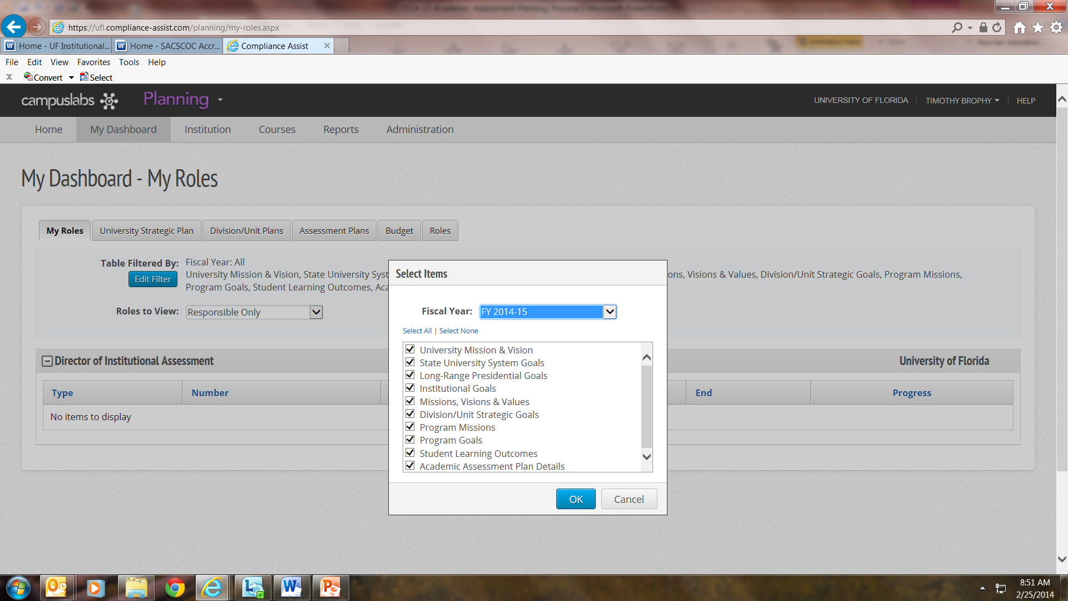
My Dashboard – My Roles
At this page, first click Edit Filter and select 2014-15 from the Fiscal Year drop down list, and click OK

Slide 8
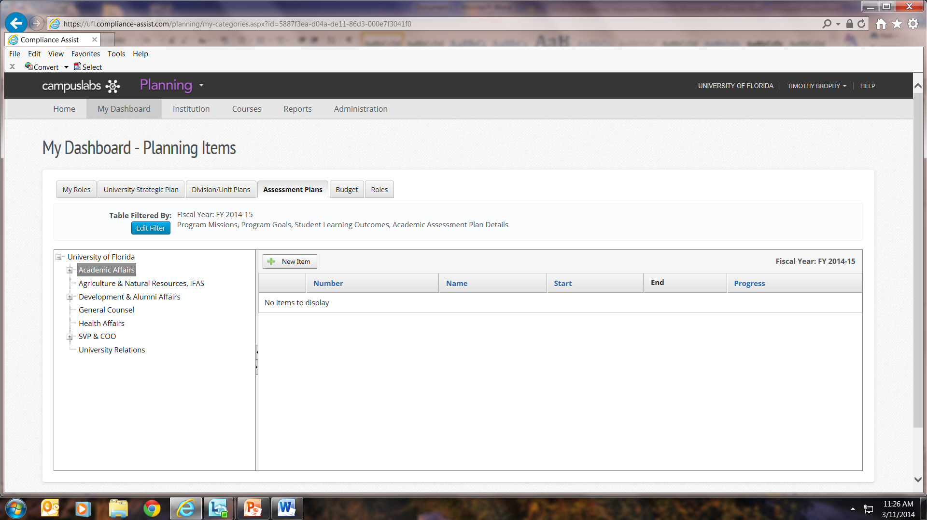
My Dashboard – Assessment Plans
Next, click the tab marked Assessment Plans
The Unit list appears in the left column

Slide 9
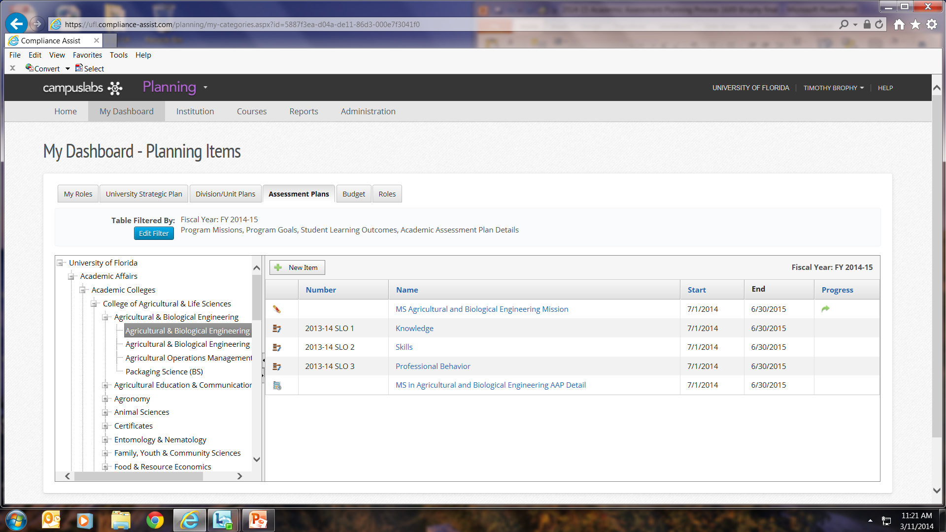
Find your program
Next, clicking on the + symbols, open Academic Affairs, then Academic Colleges, then your college, then your program(s) or certificate(s)
Here I’ve opened the materials for the MS in Ag & Bio Engineering
You will find the program mission, the 2013-14 SLOs, and the AAP (Academic Assessment Plan) detail – these have been rolled over into 2014-15 for you

Slide 10
Editing your Plan for 2014-15
Updating your 2013-14 Academic Assessment Plan for 2014-15

Slide 11
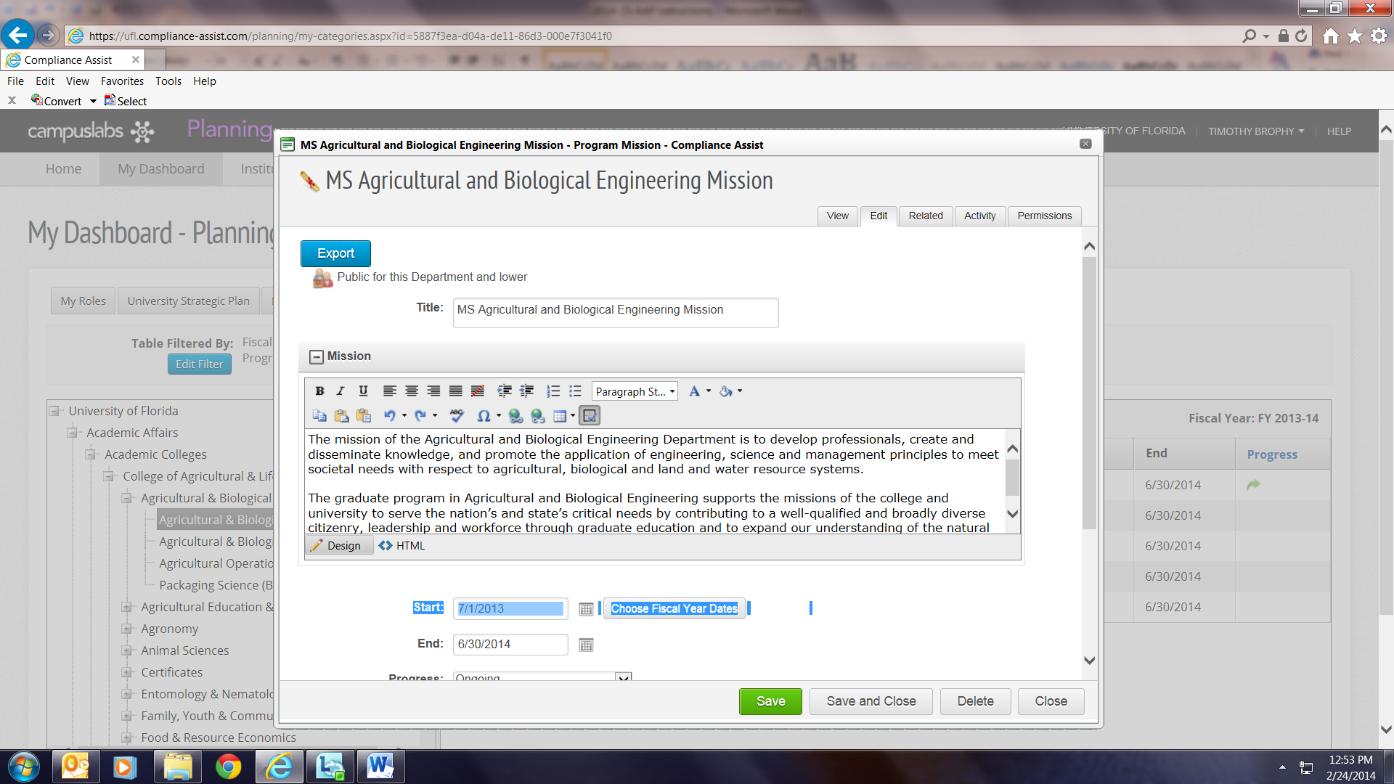
Mission
If you have modified your mission, open the mission link, click on the Edit tab, modify as needed, then save and close. Otherwise, no changes are needed.

Slide 12
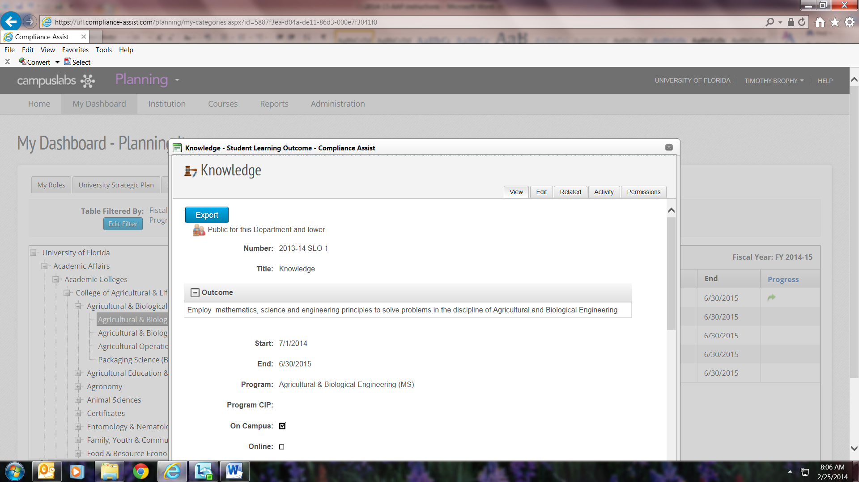
Student Learning Outcomes
Open each outcome, click the Edit tab, and update the Number to 2014-15 SLO #
Do not modify the existing text of your outcomes, or add new SLOs.
IF you wish to modify the wording of your existing outcomes or create new outcomes for 2014-15, you must complete the appropriate change form at http://approval.ufl.edu/ and submit this form only by April 4.
The ACC will review your changes at its April meeting and when they are approved, these will be entered into the 2014-15 catalog.
Change to 2014-15 SLO 1

Slide 13
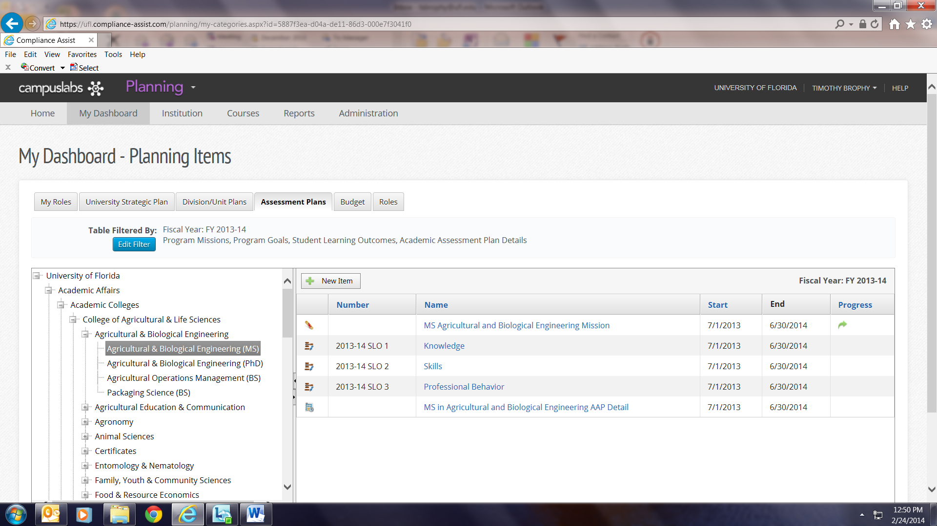
AAP Detail – Existing AAPs
If you are editing your 2013-14 plan for 2014-15, open the AAP detail link.

Slide 14
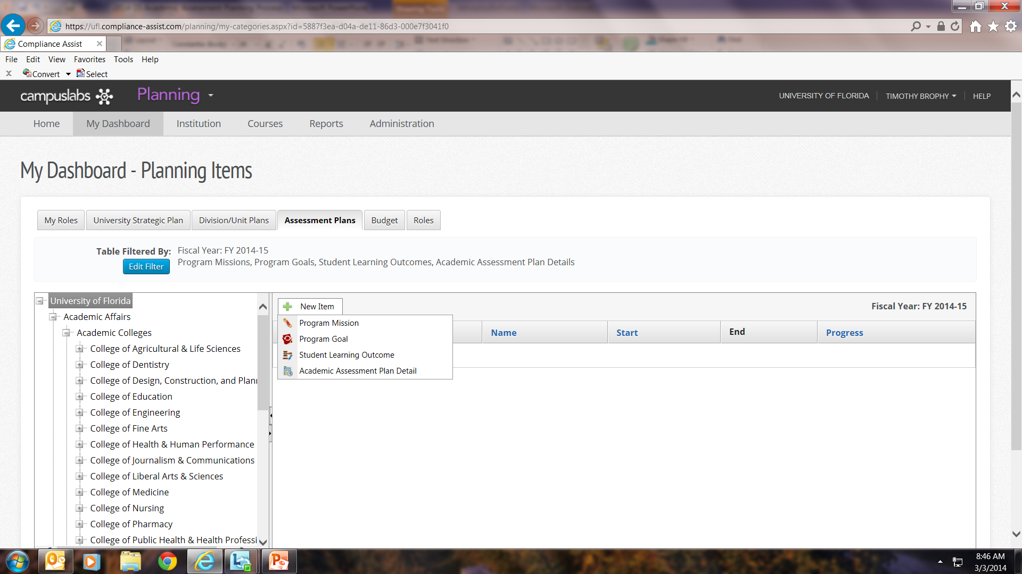
AAP detail – New AAPs
If you are developing a new plan for 2014-15, open the “new item” box and select “AAP detail,” which will open a blank form.

Slide 15
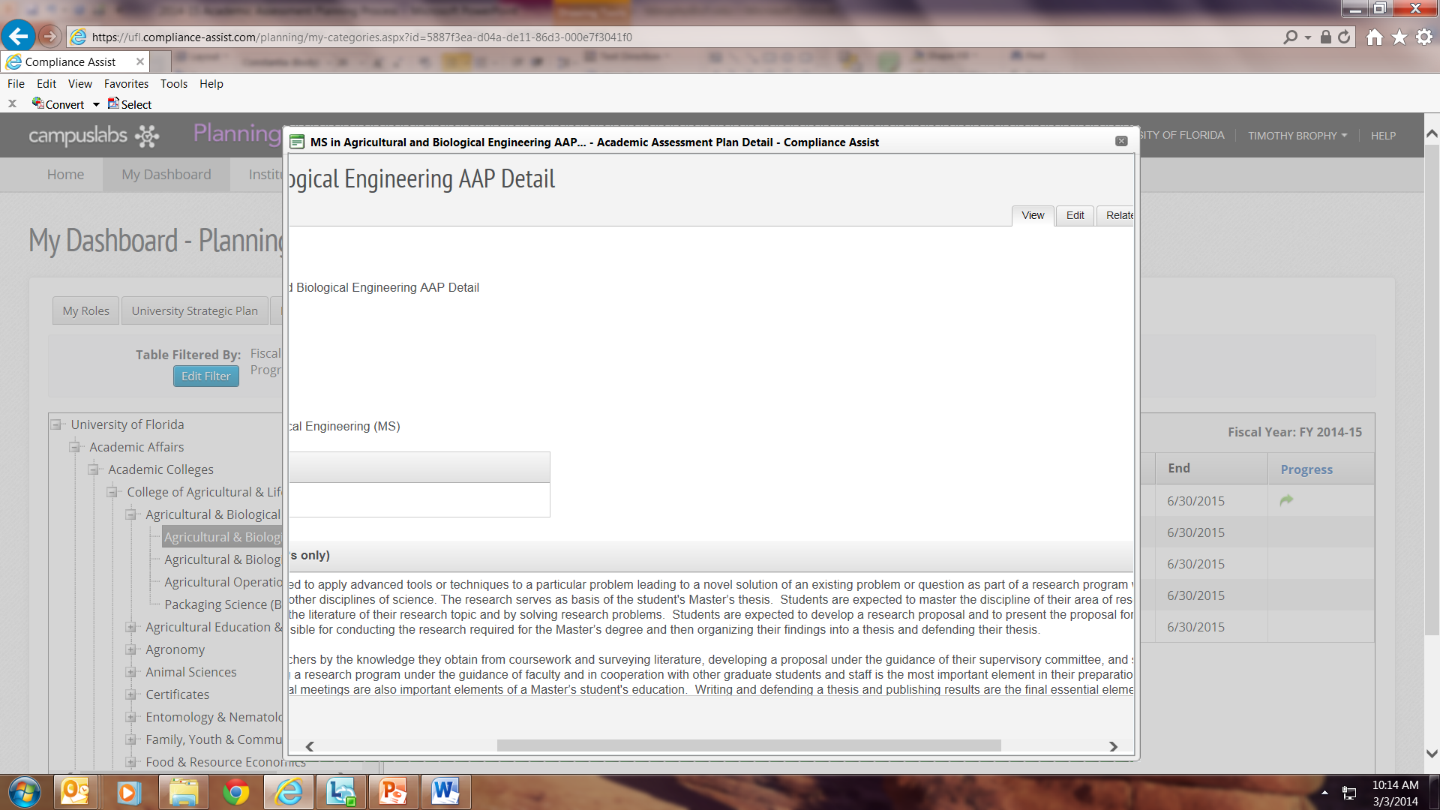
Editing fields in the AAP detail
First, click on the “Edit” tab. Of you don’t see the Edit tab in your window, slide the field to the right until it comes into view.

Slide 16
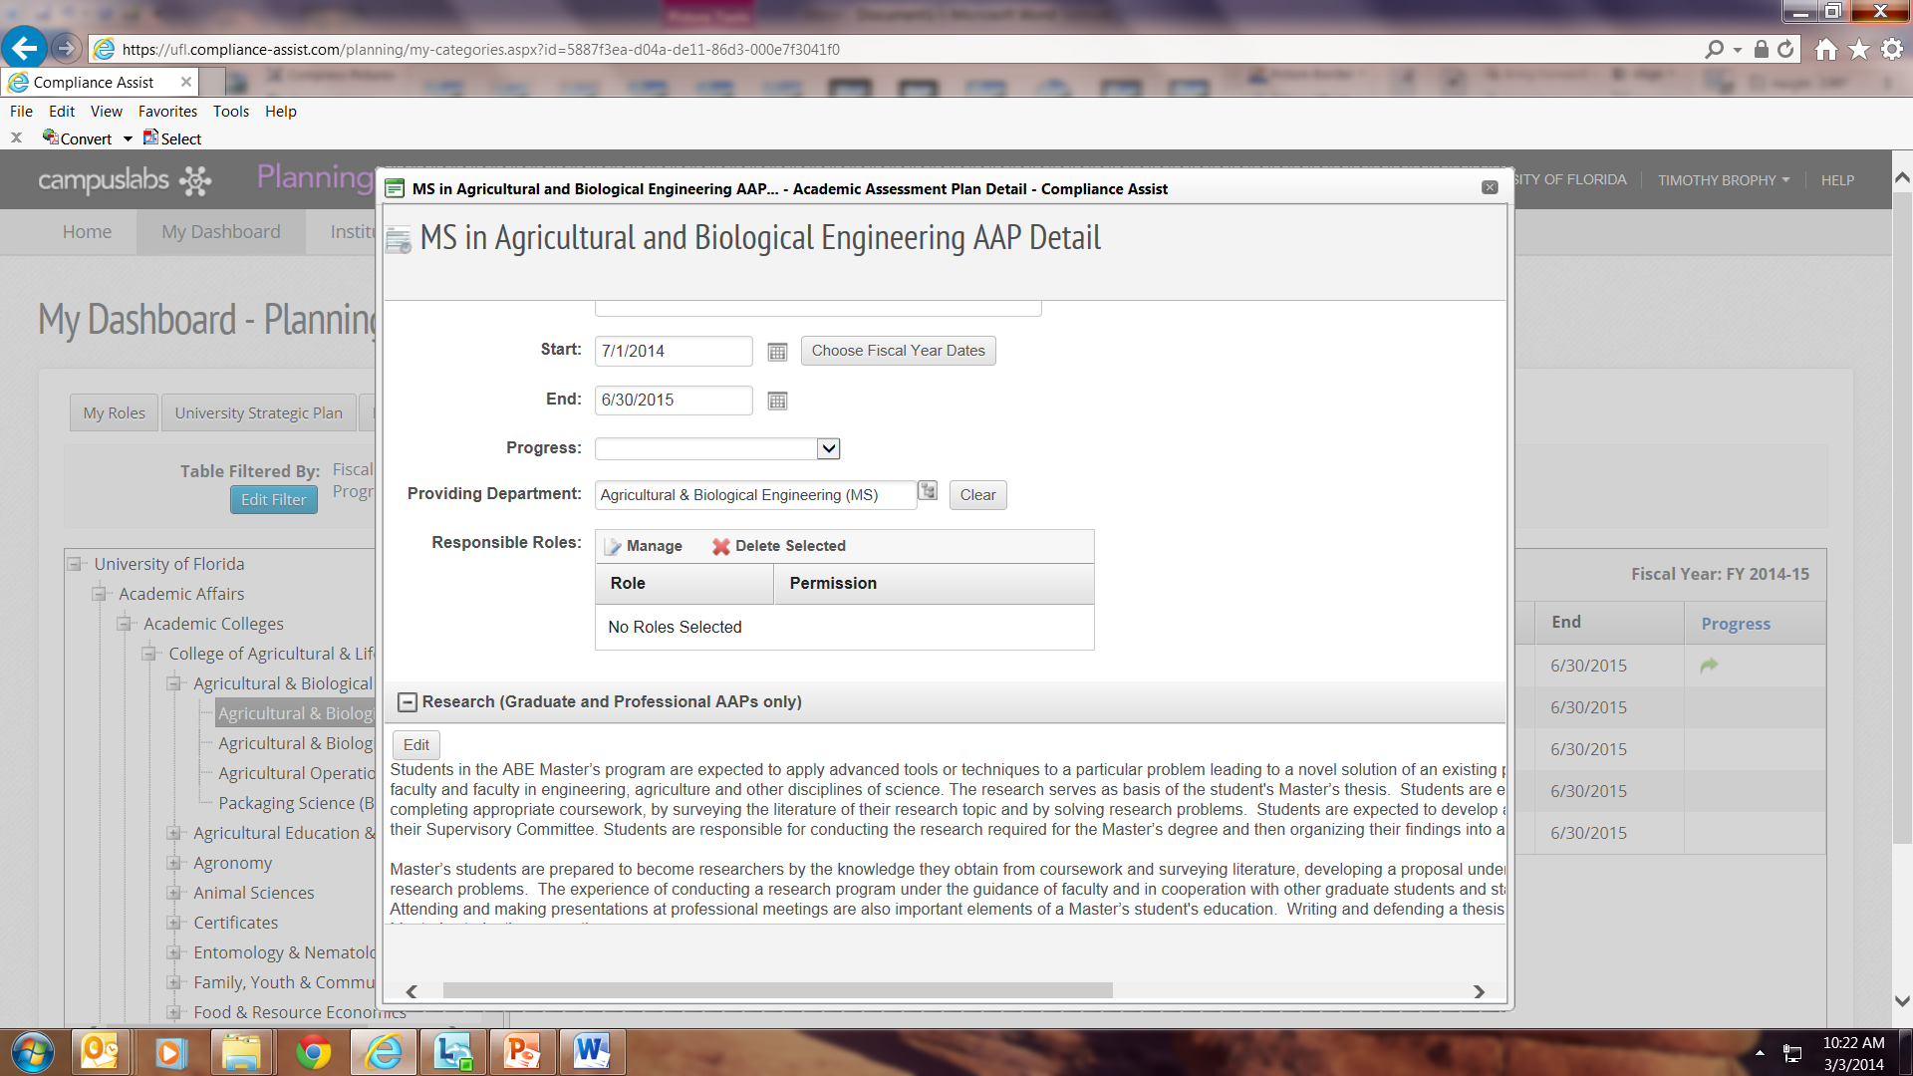
Editing fields in the AAP detail
Enter the progress field and the person responsible (responsible role)

Slide 17
Editing fields in the AAP detail
Click on the “edit” button to open the windows you wish to edit.

Slide 18
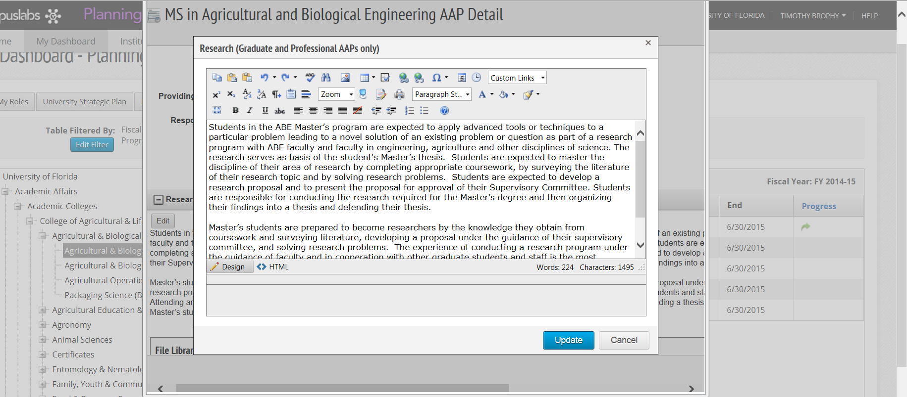
Editing Fields in the AAP detail
When you are finished editing, click on “update” and the field will update the field with the new information. Do this with each field you edit. NOTE: Update does not save the information – that step comes later.

Slide 19
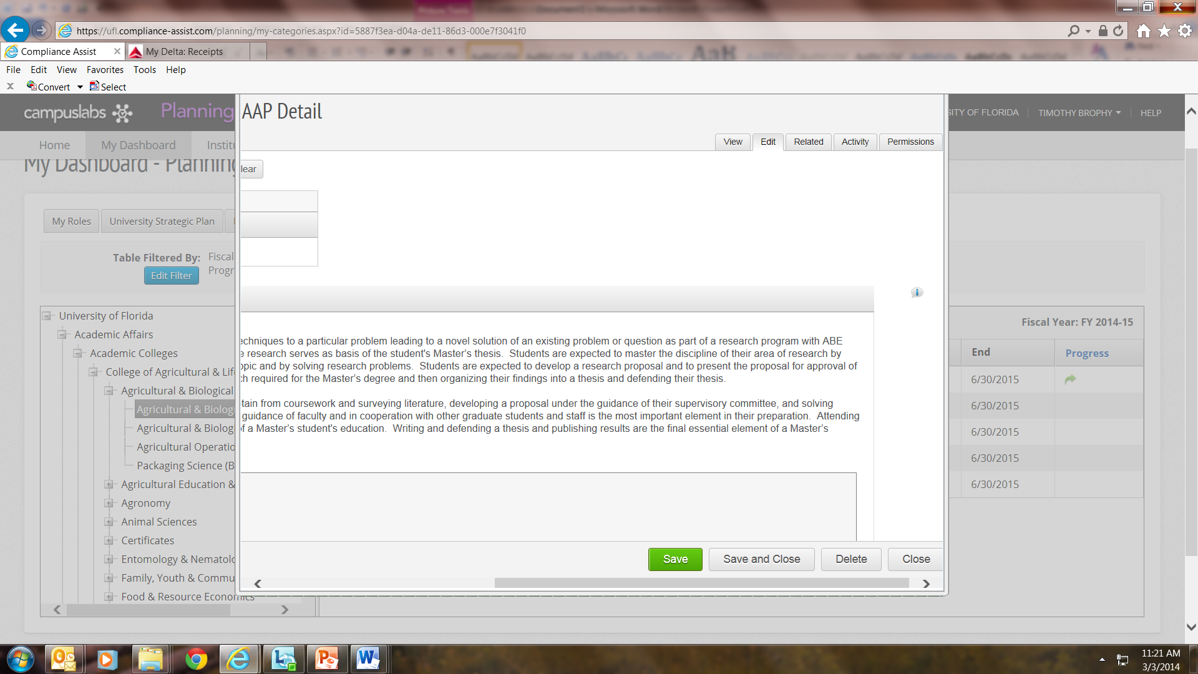
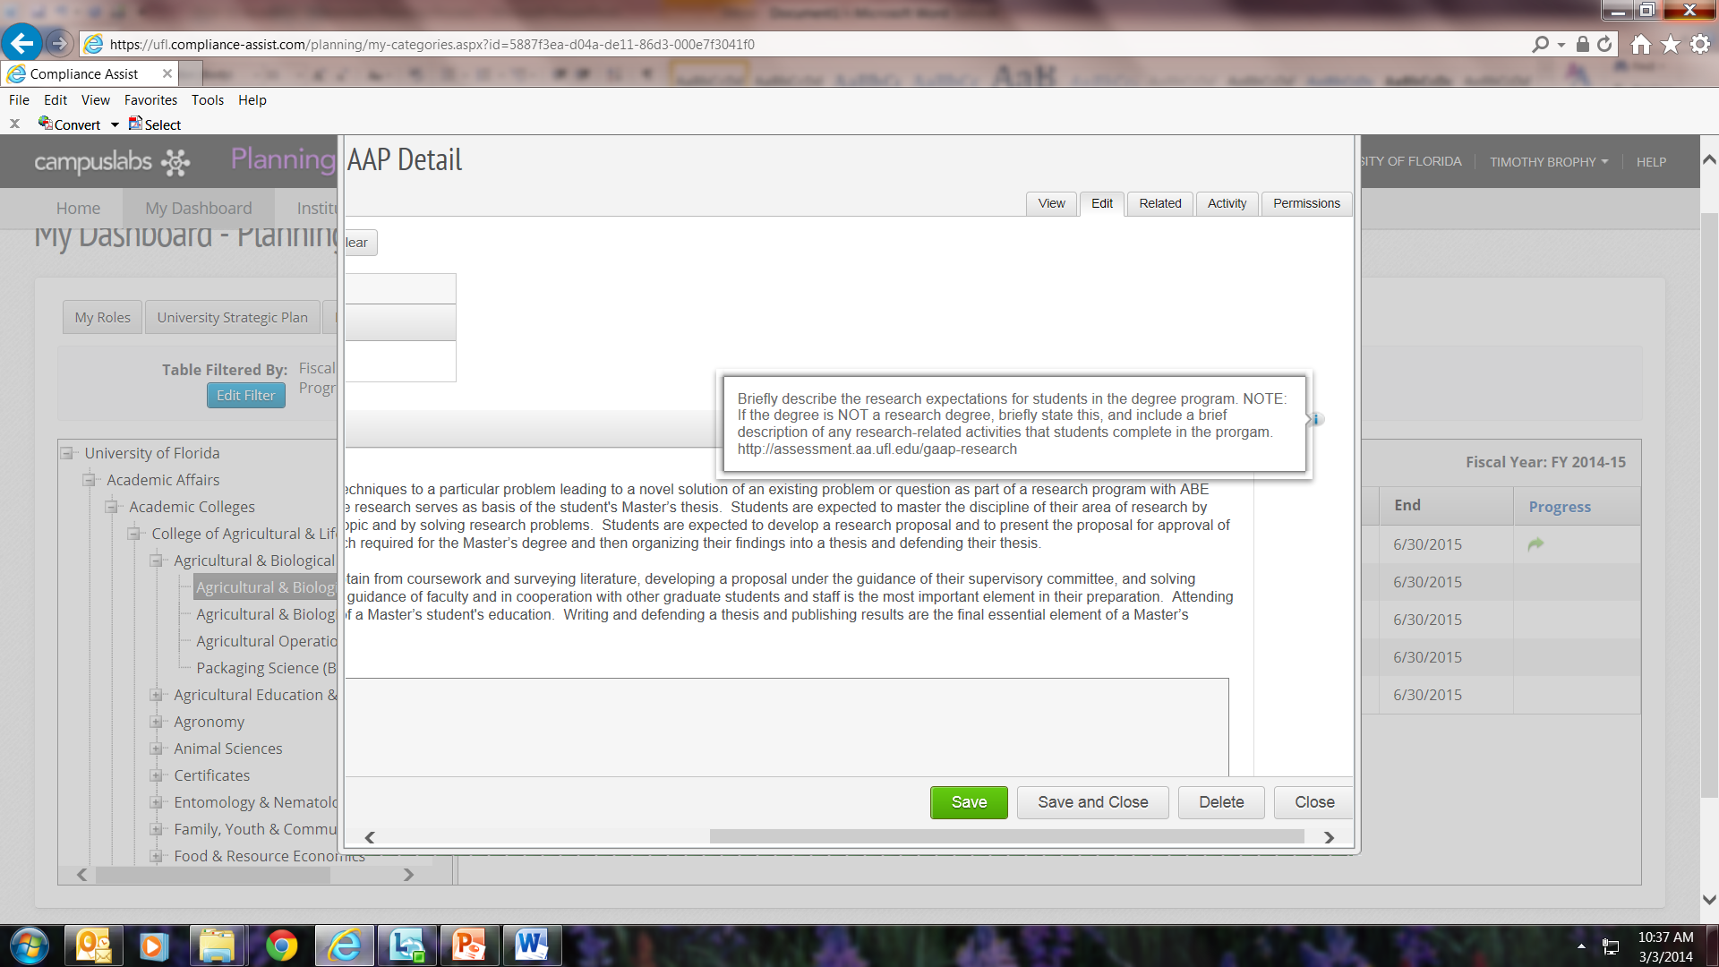
Need instructions?
When you are in Edit mode, instructions are located to the right of the field – hover over the information icon and the instructions will appear

Slide 20
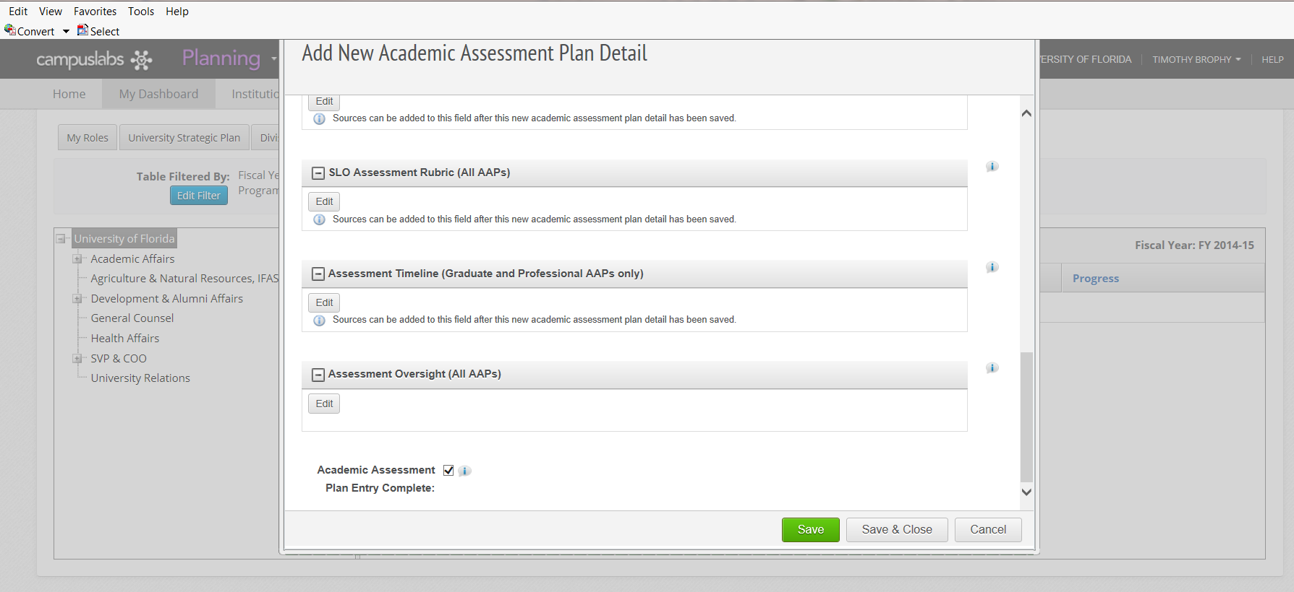
Closing out and saving changes
When you have completed entering changes into the AAP detail page, check the “Academic Assessment Plan Entry Complete” box – this is your affirmation that the plan is complete
please be sure to “save and close” – otherwise your entries will be lost

Slide 21
Checklist
Update the SLO Number fields to reflect 2014-15
IF you have modified your ALC or SLOs for 2014-15, you must use the appropriate SLO/ALC change forms at http://approval.ufl.edu/ > Undergraduate, Graduate, or Professional > ALC/SLO/Academic Assessment Plan
Edit the AAP detail for 2014-15, check the “Completed” box at the bottom of the detail
SAVE AND CLOSE
You will be notified when the Academic Assessment Committee approves any changes to your ALC/SLOs and you can then enter your changes into the Compliance Assist! AAP detail page

Slide 22
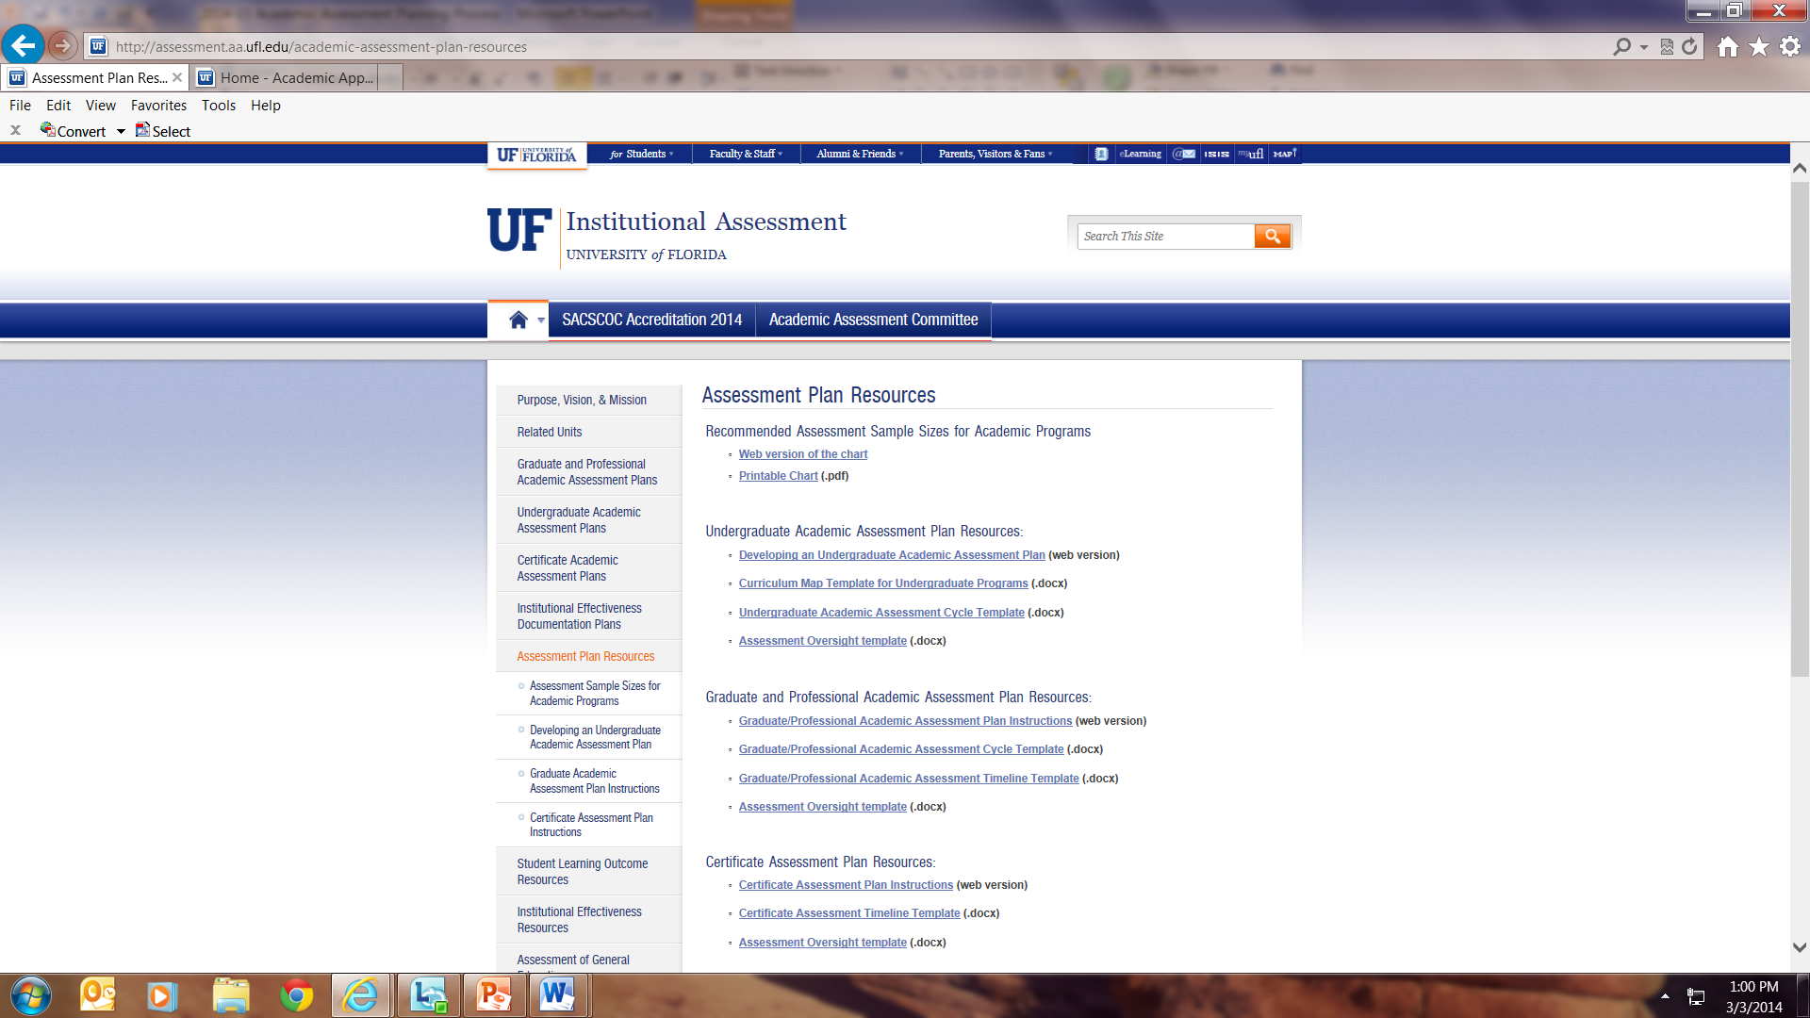
Resources for 2014-15
The Institutional Assessment Resources page has been updated with current forms and information
http://assessment.aa.ufl.edu/academic-assessment-plan-resources

Slide 23
Need further assistance?
Email assessment@aa.ufl.edu with your questions, OR
Call Institutional Assessment at 352-273-1090

